Slide 1
Object Oriented Analysis and Design

Slide 2
State Modeling

Slide 3

Introduction
→We can understand the system by first examining its static structure (class model).
→Then we should examine changes to the objects and their relationship over time and it is given by state model.
→The state model describes the sequences of operations that occur in response to external stimuli.
→The state model consists of multiple state diagrams, one for each class with temporal behavior that is important to an application.
UML 56

Slide 4

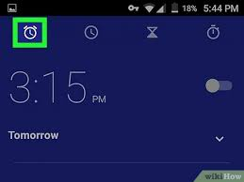
1. Events
◆ An Event is an occurrence at a point in time, such as user depresses left button of the mouse or flight 123 departs from Chicago.
◆ Events often correspond to verbs in the past tense like
power turned on
alarm set
◆
UML 57

Slide 5
By definition an event happens instantaneously with regard to the time scale of an application.

Slide 6

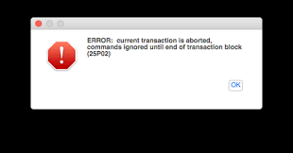

Events continue…
◆ Events include error conditions as well as normal occurrences. For example
Paper jammed
transaction aborted
Timeout
UML 58

Slide 7

There are several kinds of events but following are most common events.
signal event
change event
time event

Slide 8
1.1 Signal Event
◆ A signal is an explicit one-way transmission of information from one object to another.
◆ If object want to reply then use the separate signal.
◆ A signal event is the event of sending or receiving a signal.
◆ We are more concern about the receipt of a signal because it causes effects in the receiving object.
◆ The UML notation is the keyword signal in guillemets(<<>>) above the signal class name in the top section of a box.
UML 59

Slide 9
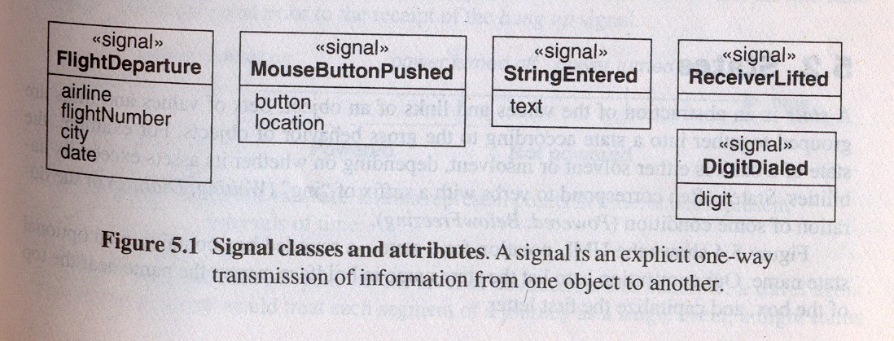
Signal Event Continue…
◆ For example, UAflight 123 departs from chicago on January 10,1991 is an instance of signal class FlightDeparture.
UML 60

Slide 10
1.2 Change Event
◆ A change event is an event that is caused by the satisfaction of a boolean expression.
◆ The intent of a change event is that the expression is continually tested whenever the expression changes from false to true, the event happens.
◆ The UML notation for a change event is the keyword “when” followed by a parenthesized boolean expression.
◆ Examples:
When (room_temp<heating_set_pt) When (bat_power < lower_limit)
UML 61

Slide 11
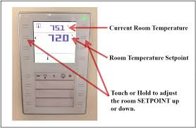


Examples:
When (room_temp<heating_set_pt)
When (bat_power < lower_limit)
When (tire_pressure < in.pressure)

Slide 12
1.3 Time Event
◆ A time event is an event caused by the occurrence of an absolute time or the elapse of a time interval.
◆ The UML notation for an absolute time is the keyword when followed by a parenthesized expression involving time.
◆ The notation for a time interval is the keyword after followed by a parenthesized expression that evaluates to a time duration.
◆ Examples:
◆ When (date=Jan 1,2000)
◆ After (10 seconds)
UML 12

Slide 13
2. States
◆ A state is an abstraction of the values and links of an object.
◆ States often correspond to verbs with a suffix of “ing” (Waiting, Dialing) or the duration of some condition (Powered, BelowFreezing).
◆ UML notation for a state is a rounded box containing an optional state name. examples:
Waiting
Dialing
Powered
BelowFreezing
UML 13

Slide 14
States Continue…
◆ Each object can only be in one state at a time.
◆ Objects may parade through one or more states during their lifetime.
◆ At a given moment of time, the various objects for a class can exist in a multitude of states.
◆ A state specifies the response of an object to input events.
◆ The response may include the invocation of behavior or a change of state.
◆ For example: if a digit is dialed in state Dial tone, the phone line drops the dial tone and enters state Dialing.
UML 14

Slide 15
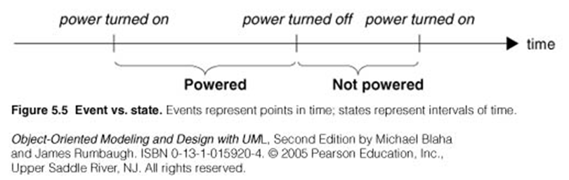
Event vs. State
Events Represents points in time whereas States represents intervals of time.

Slide 16
3.Transitions and conditions
◆ A transition is an instantaneous change from one state to another.
◆ For example, when a called phone is answered, the phone line transition from the Ringing state to the Connected state.
◆ The transition is said to fire upon the change from the source state to the target state.
◆ The choice of the next state depends on both the original state and the event received.
◆ An event may cause multiple objects to transition from a conceptual pUMoL i6n5 t of view such transition occur concurrently.

Slide 17

Guard Condition
◆ A guard condition is a Boolean expression that must be true in order for a transition to occur.
◆ A guarded transition fires when its event occurs, but only if the guard condition is true.
◆ For example “when you go out in the morning (event), if the temperature is below freezing (condition), then put on your gloves (next state).”
◆ A guard condition is checked only once, at the time the occurs and transition fires if the guard condition is true.
◆ A guard condition is checked only once while a change event is in effect
UML 66
checked continuously.

Slide 18
Guard Condition Continue…
◆ The UML notation for a transition is a line from origin state to target state.
◆ An arrowhead points to the target state.
◆ The line may consist of several line segments. An event may label the transition and be followed by an optional guard condition in square brackets.
◆ We italicize the event name and show the condition in normal font.
UML 67

Slide 19
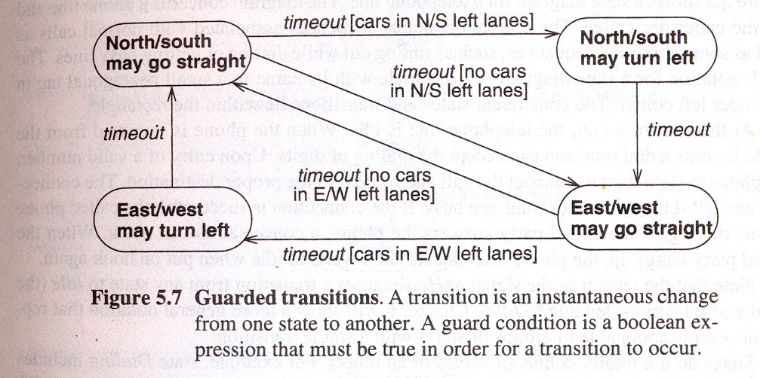
Guard Condition Continue…
→Following fig. shows guarded transitions for traffic lights at an intersection.
UML 68

Slide 20
4. State Diagram
A state diagram is a graph whose nodes are states and whose directed arcs are transitions between states.
A state diagram specifies or describes the state sequence caused by event sequences.
State names must be unique within the scope of the state diagram.
All objects in a class execute the state diagram for that class.
The class state diagram models the common behavior of the class objects.

Slide 21
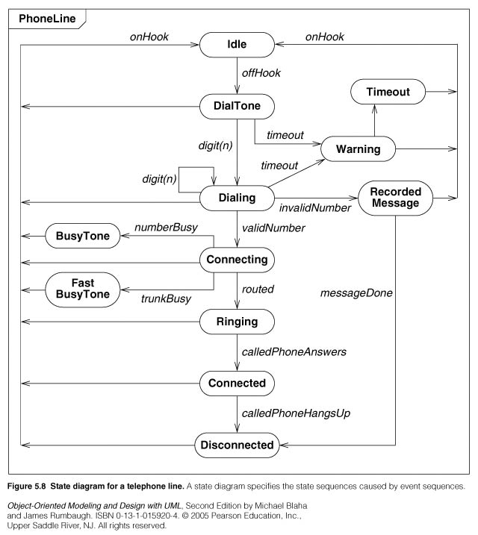
State diagram example

Slide 22
One shot State Diagrams
represent objects with finite lives
– have initial and finite states
• initial state
-- entered on object creation
• final state
- entry implies destruction of object

Slide 23

One-shot state diagram for Chess Game

Slide 24
One shot diagram for Chess Game using entry exit points

Slide 25
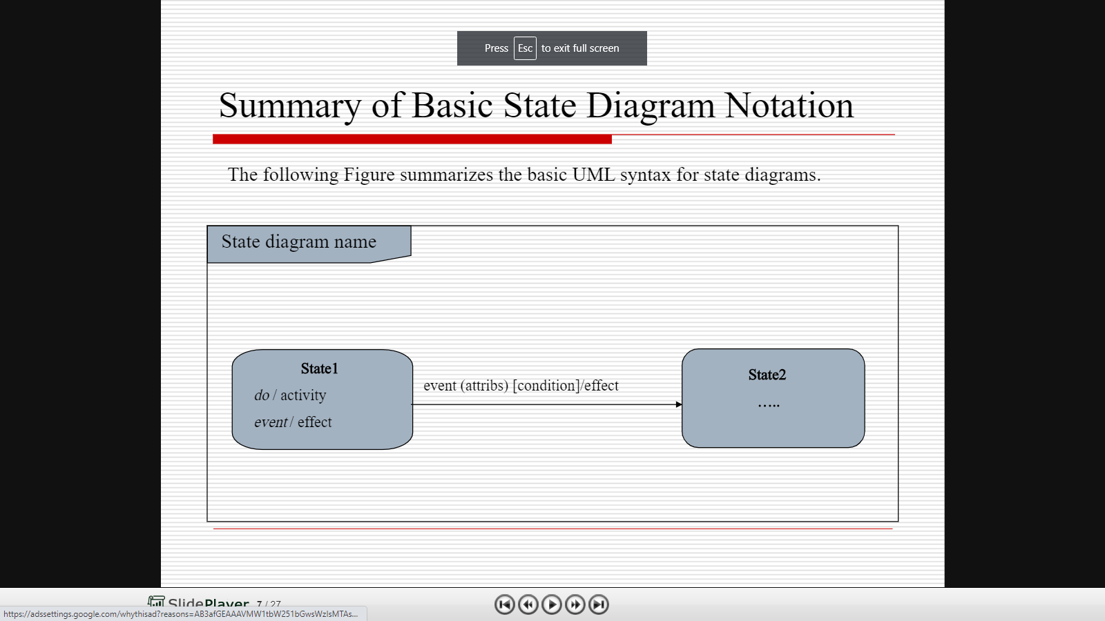

Slide 26
Summary of Basic State Diagram Notation
State. Drawn as a rounded box containing an optional name. A special notation is available for initial states (a solid circle ) and final states (a bull’s- eye or encircled “x” ).
Transition. Drawn as a line from the origin state to the target state. An arrowhead points to the target state. The line may consist of several line segments
Event. A signal event is shown as a label on a transition and may be followed by parenthesized attributes. A change event is shown with the keyword when followed by a parenthesized boolean expression. A time event is show with the keyword when followed by a parenthesized expression involving time or the keyword after followed by a parenthesized expression that evaluates to a time duration.
State diagram. Enclosed in a rectangular frame with the diagram name in a small pentagonal tag in the upper left corner.

Slide 27
Guard condition. Optionally listed in square brackets after an event.
Effects. Can be attached to a transition or state and are listed after a slash (“/”). Multiple effects are separated with a comma and are performed concurrently. (you can create intervening states if you want multiple effects to be performed in sequences)
Some style conventions.
List the state name in boldface with the first letter capitalized
Italicize event names with the initial letter in lower case
Guard conditions and effects are in normal font and also have the initial letter in lower case.
Confine transition line segments to a rectilinear grid.

Slide 28
5. State Diagram Behaviour
5.1 Activity Effects
5.2 Do-Activities
5.3 Entry and Exit Activities
5.4 Completion Transition
5.5 Sending Signals

Slide 29

5.1 Activity Effects
An effect is a reference to a behavior that is executed in response to an event.
An activity is the actual behavior that can be invoked by any number of effects.
An activity may be performed upon a transition, upon the entry to or exit from a state, or upon some other event within a state.
Activities can also represent internal control operations, such as setting attributes or generating other events.
Such activities have no real-world counterparts but instead are mechanisms for structuring control within an implementation. For example, a program might increment an internal counter every time a particular event occurs.

Slide 30
The notation for an activity is a slash (“/”) and the name (or description) of the activity, following the event that causes it.
The keyword do is reserved for indicating an ongoing activity and may not be used as an event name.

Slide 31

5.2 Do -Activities
◆ A do-activity is an activity that continues for extended time.
◆ It can only occur within a state and can not be attached to a transition.
◆ For example the warning light may flash during the paper jam state for a copy machine.
◆ Do-activities include continuous operations such as displaying a picture on a television screen as well as sequential operations that terminate by themselves after an interval of time.
UML 31

Slide 32
Do –Activities Continue…
◆ The notation “do /” denotes a do-activity that may be performed for all or part of the duration that an object is in a state.
◆ A do-activity may be interrupted by an event that is received during its execution.
Paper jam
Do / flash warning light
UML 32

Slide 33

5.3 Entry and Exit Activities
As an alternative to showing activities on transitions, you can bind activities to entry or to exit from a state.
There is not difference in expressive power between the two notations, but frequently all transitions into a state perform the same activity, in which case it is more concise to attach the activity to the state.
The next figure shows the control of a garage door opener.

Slide 34
Activities on Transition

Slide 35
Activities on Entry to state

Slide 36
Exit activities are less common than entry activities, but they are occasionally useful.
An exit activity is shown inside the state box following the keyword exit and a “/” character.
Whenever the state is exited, by any outgoing transition, the exit activity is performed first.
If a state has multiple activities, they are performed in the following order: activities on the incoming transition, entry activities, do-activities, exit activities, activities on the outgoing transition.
Events that cause transitions out of the state can interrupt do-activities.
If a do-activity is interrupted, the exit activity is still performed
In general, any event can occur within a state and cause an activity to be performed. Entry and exit are only two examples of events that can occur.

Slide 37
Events within a state vs. self-transition
As the next figure shows, there is a difference between an event within a state and a self-transition; only the self-transition causes the entry and exit activities to be executed.

Slide 38

5.4 Completion Transition

Slide 40

5.5 Sending Signals

Slide 41

Practical Tips
Abstracting values into states. Consider only relevant attributes when defining a state. State diagrams need not use all attributes shown in a class model.
Parameter. Parameterize events for incidental data that don not affect the flow of control.
Granularity of events and states. Consider application needs when deciding on the granularity of events and states.
When to use state diagrams. Construct state diagrams only for classes with meaningful temporal behavior. A class has important temporal behavior if it responds differently to various events or has more than one state. Not all classes require a state diagram.
Entry and exit activities. When a state has multiple incoming transitions, and all transitions cause the same activity to occur, use an entry activity within the state rather than repeatedly listing the activity on transition arcs. Do likewise for exit activities.

Slide 42
Guard conditions. Be careful with guard conditions so that an object does not become “stuck” in a state.
Race conditions. Beware of unwanted race conditions in state diagrams. Race conditions may occur when a state can accept events from more than one object.

Slide 43

Guided Project

Slide 44
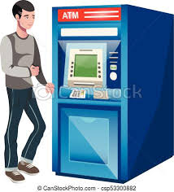
Bank ATM behavioral state machine UML diagram example
An example of UML behavioral state machine diagram describing Bank Automated Teller Machine (ATM) top level state machine.
ATM is initially turned off. After the power is turned on, ATM performs startup action and enters Self Test state. If the test fails, ATM goes into Out of Service state, otherwise there is triggerless transition to the Idle state. In this state ATM waits for customer interaction.

Slide 45
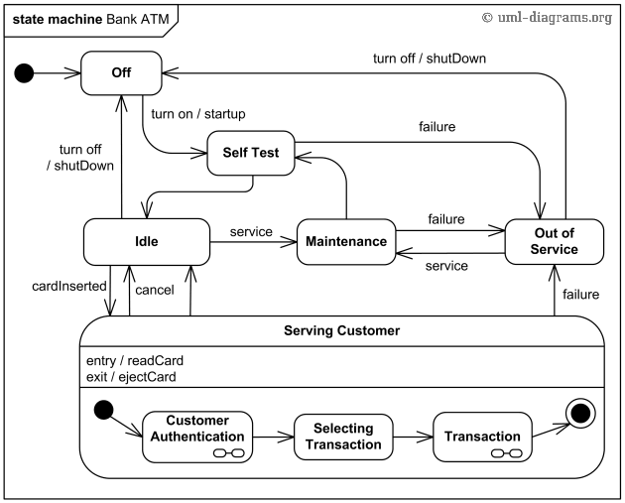

Slide 46
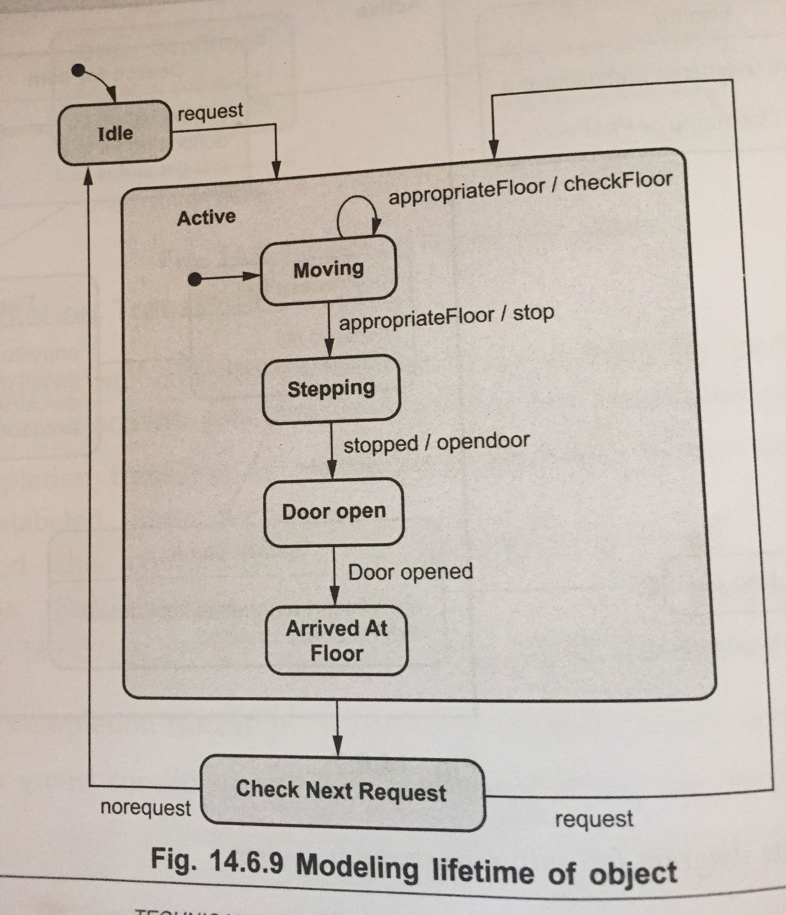
State Diagram of Elevator

